Slide 1
User Generated Content and Product Comparison Networks
User Generated Content Analytics
September 28, 2017

Slide 2
A Bit More on the PMI Approach
Useful when not accompanied by sentiment bearing adjectives or phrases
What if an adjective can be found in the “vicinity” of the POS phrase?
What if the POS phrase contains a sentiment bearing adjective?
E.g., “This camera produces beautiful pictures.”

Slide 3
A More Practical Approach to Unsupervised Sentiment Analysis
Use weights (e.g., +5 to -5) on a list of words (lexicon)
Essentially add up individual weights
Some nuances including sentiment shifters (e.g., “However”, “But”, etc.)
Used widely, e.g., SentiStrength (free tool)
Can be made context sensitive by adjusting weights and/or adding words

Slide 4
Multiple Products, Multiple Attributes
“The lobby of the Coastal Delight was cool, but the room was nothing to write home about; the food was good, but the location was too far away from transportation. In hindsight, although the Tuscany Grand was very pricey, its awesome location and high-end ambience would have been great.”
Assumption: People express emotions in close proximity to the mentions of entities and/or attributes.
Extract only phrases that are “relevant”
E.g., Dell & warranty, hotel & lobby, etc.
Then pass through standard sentiment analyzers

Slide 5
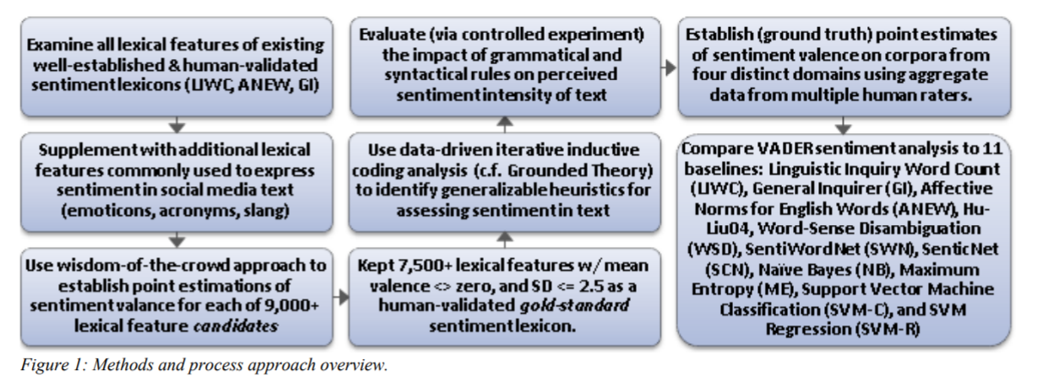
Valence Aware Dictionary for sEntiment Reasoning (VADER)
A more refined approach to unsupervised sentiment analysis
Available in Python
Source: Hutto & Gilbert 2014

Slide 6
Adds Human Heuristics for Expressing Sentiments
Punctuation, e.g., ! increases the sentiment intensity
Capitalization, e.g., ALL-CAPS
Degree modifiers, e.g., “The service here is extremely good”
Sentiment shifters, e.g., “The food here is great, but the service is horrible”
Trigram preceding a sentiment-laden lexical feature: Catch nearly 90% of cases where negation flips the polarity of the text.
E.g., “The food here isn’t really all that great”.
Source: Hutto & Gilbert 2014

Slide 7
Predicting Business Outcomes From User Generated Content
Can UGC (e.g., product reviews) predict business outcomes such as sales?
Often users mention competing products
Can we extract preference information?
Can we draw product comparison (or preference) networks?
Can such networks help predict business outcomes?
Slides based on Zhang et al. (2013) posted on Canvas

Slide 8
From Product Comparisons to Preference Networks
“The B&W P7 are high on my favorite list next to the H8 by B&O and the Grados. I also like the new P5 a lot because their sound is close to the P7 without the bulk.”
“I just love the luxury, style and performance of the Audi A6; the Lexus GS300 is a nice reliable car and a very good value, but lacks the coolness factor.”
+5
5-2 = 3 (weight)
+2
Audi A6
+3
4-3 = 1
+4
Lexus GS300
“I need a super reliable car with the great creature comforts, and while the A6 is a wonderful car, it is quite expensive; the Lexus GS300 is not exactly the lap of luxury, but really fits the bill for me in every way.”

Slide 9
The Main Idea
Directed product networks
“Prestige” or “authority” of a node
Each product review (as discussed in the article)
Primarily focuses on a product (say p₁)
May also mention p₂
Has two scores: s₁ and s₂

Slide 10
What Metric Can Capture the Relative Importance of a Product?
Create a network of product preferences
PageRank is one possibility
Developed by Larry Page and Serge Brin at Stanford
A variation of the good old eigenvector algebra
Based on how many web pages refer to a particular web page.

Slide 11
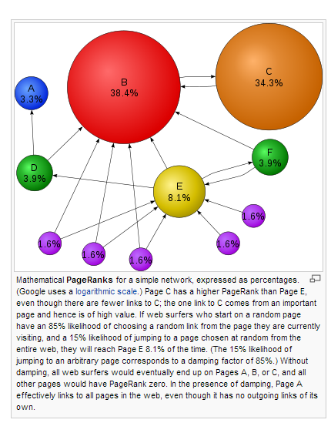
PageRank to the Rescue
If many web pages refer to a page, the latter must be important
If the referring pages are referred to by many other pages, the effect is stronger
Source: Wikipedia

Slide 12
Weighted PageRank
Not all incoming links are created equal
Different ways to create weights on links
networkx library in python can calculate weighted PageRank scores

Slide 13
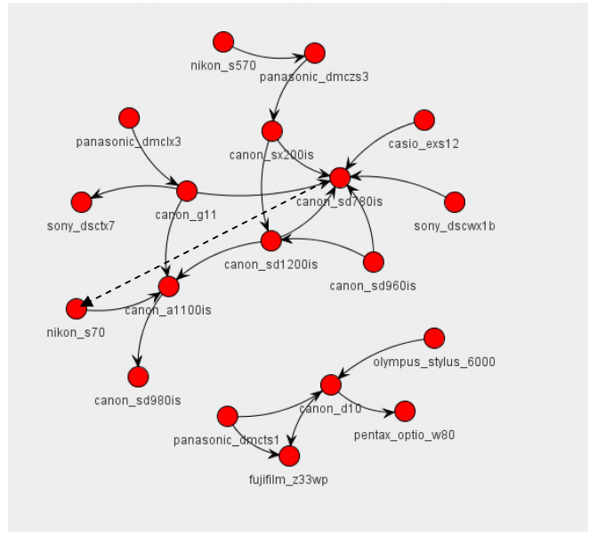
Real World Implications

